Slide 1

Toolkit Doc4 WAN Port RJ45
April 26, 2010

Slide 2
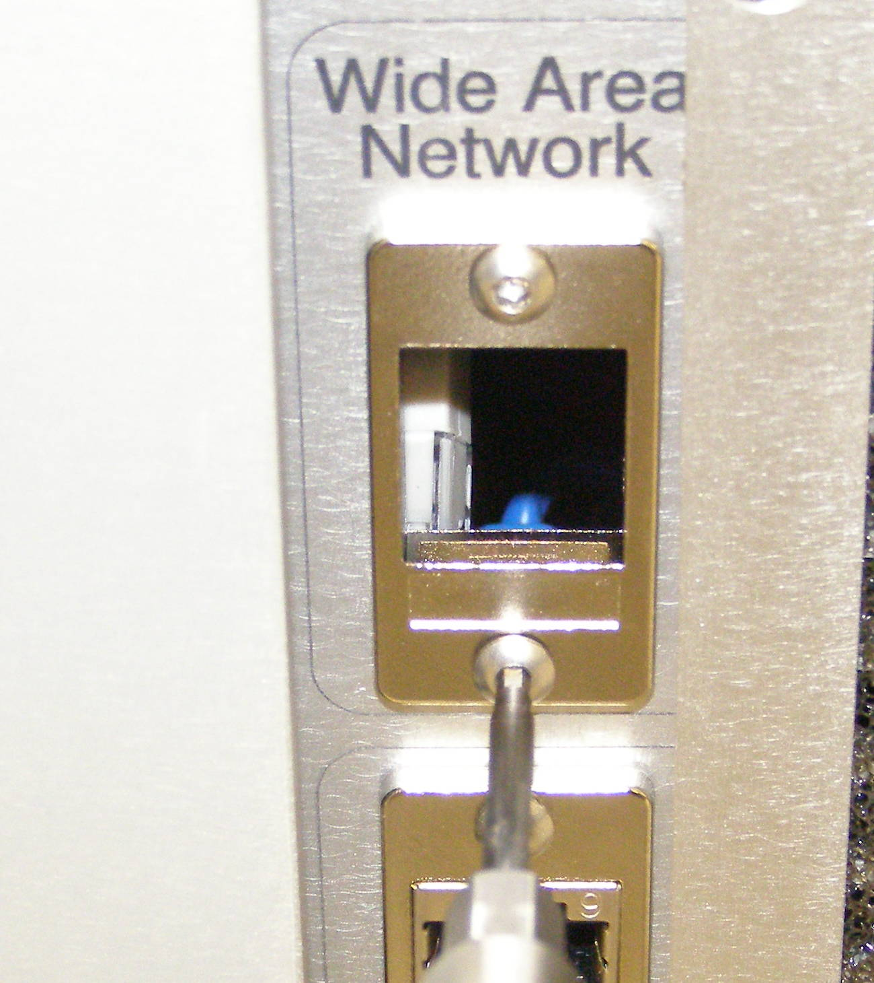
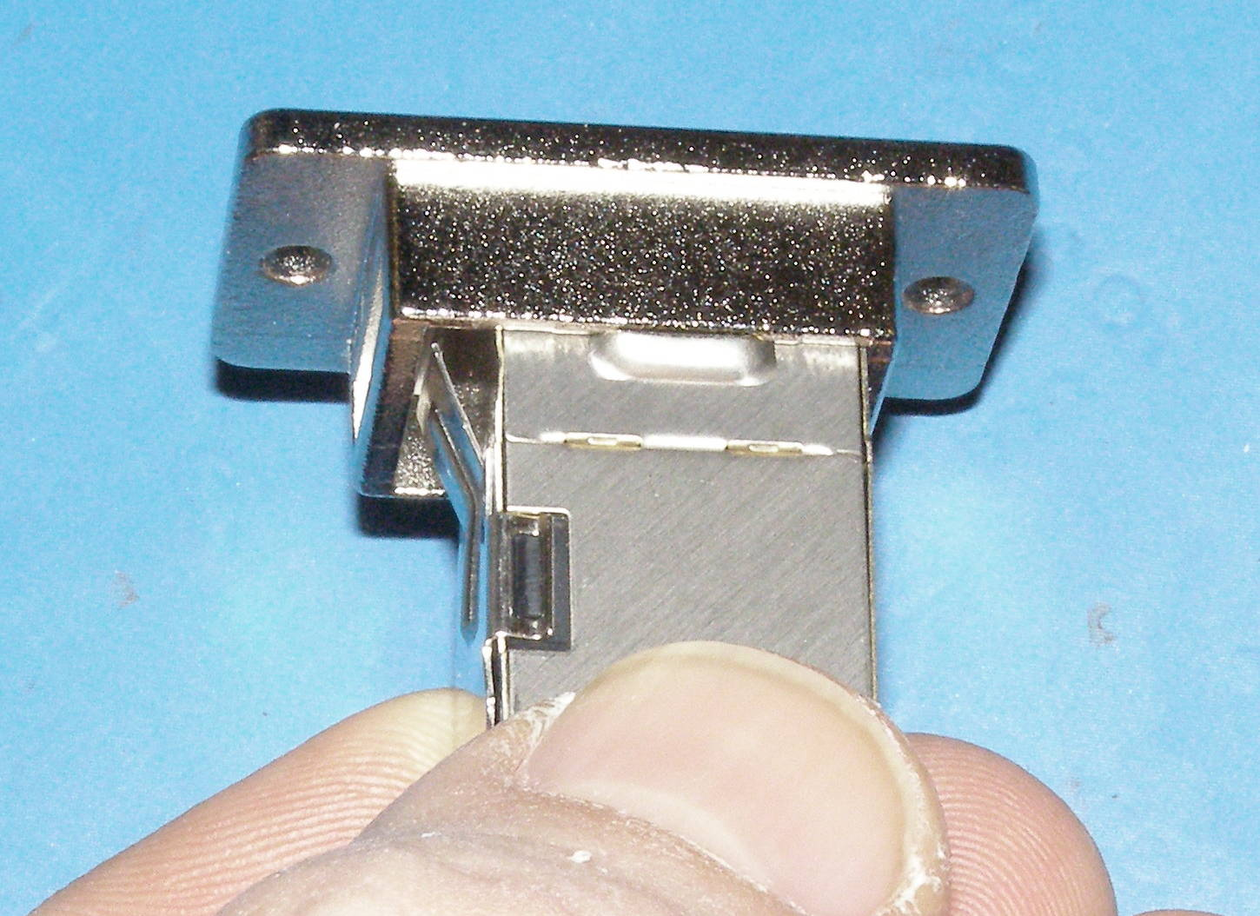
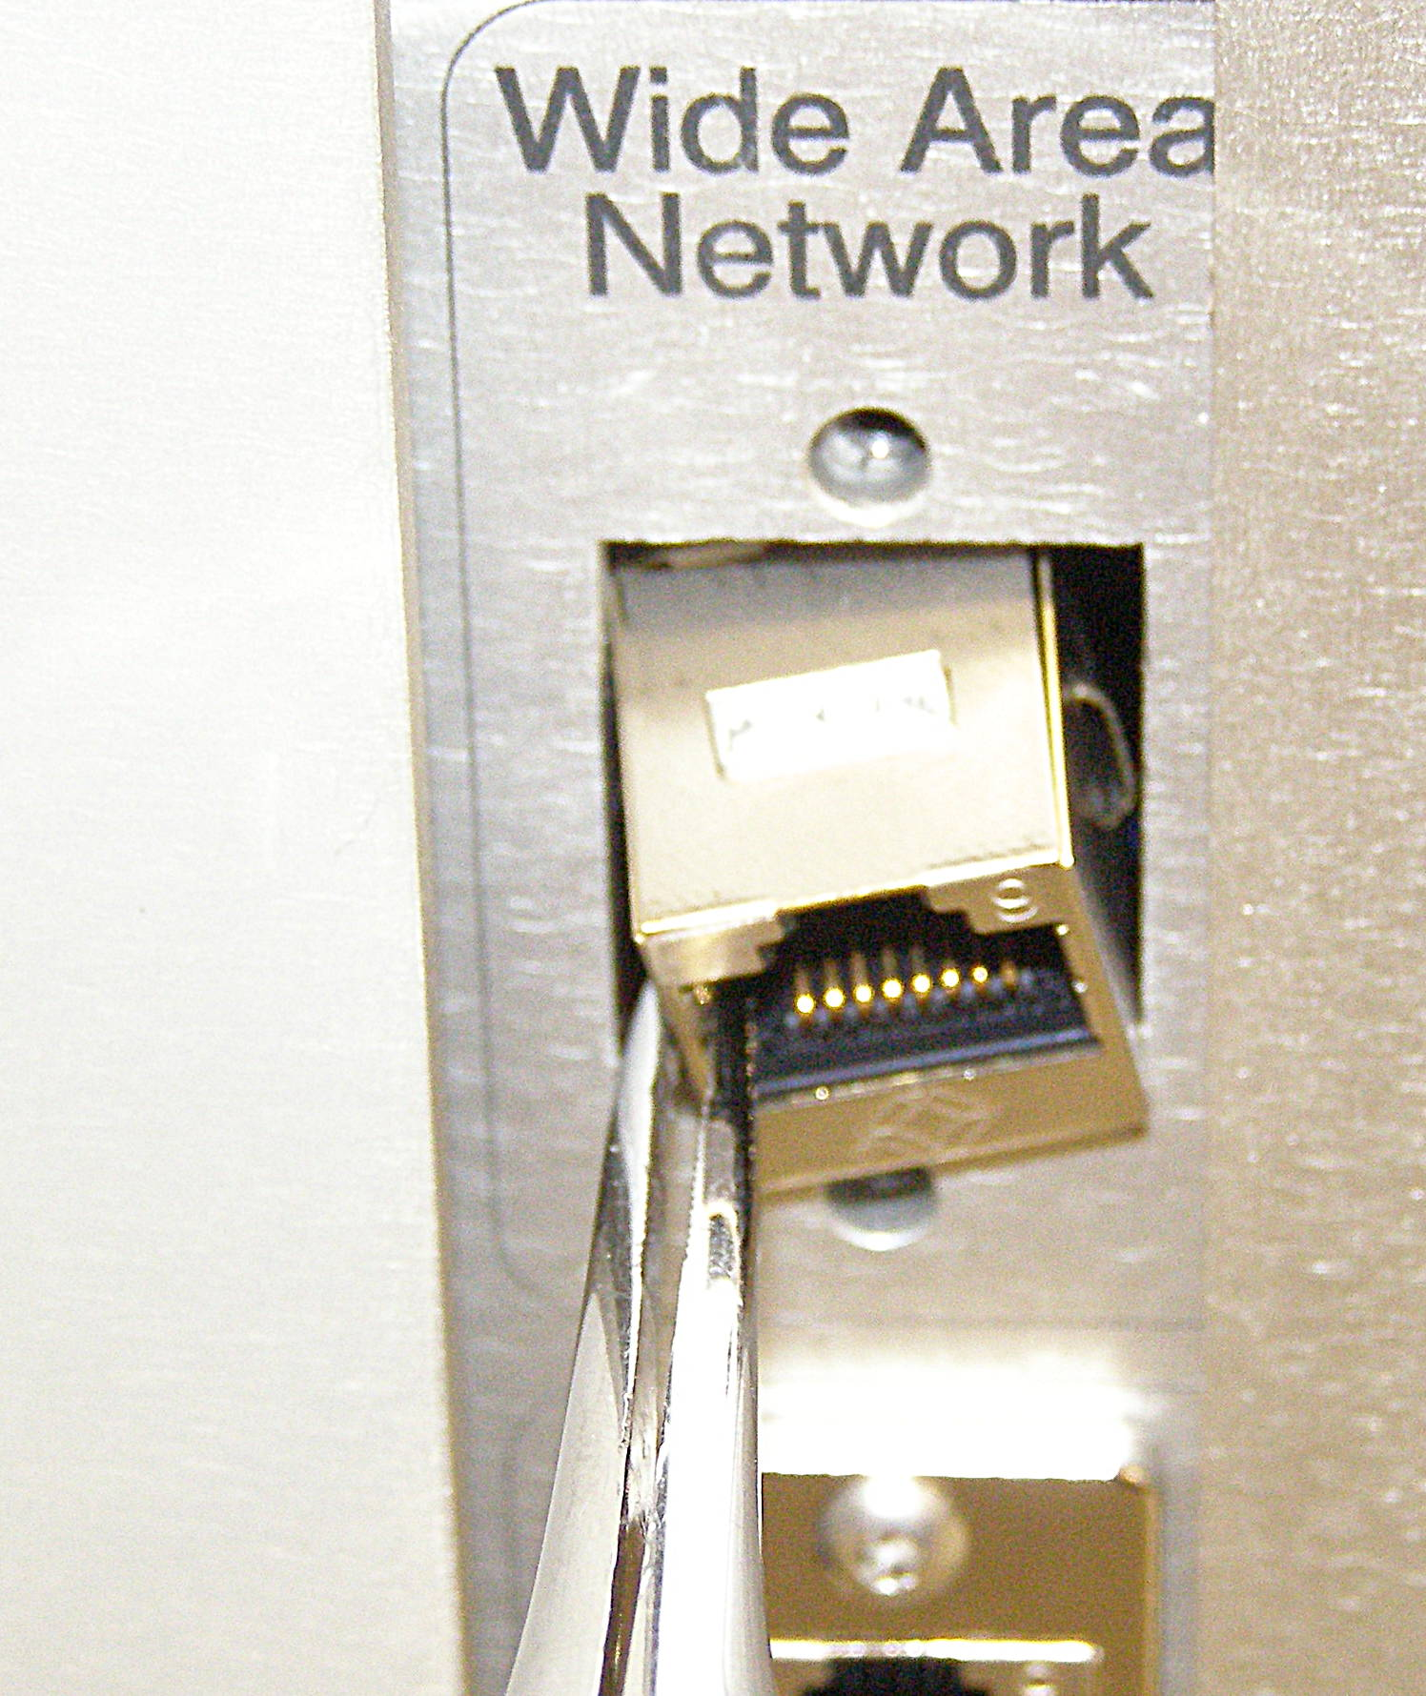
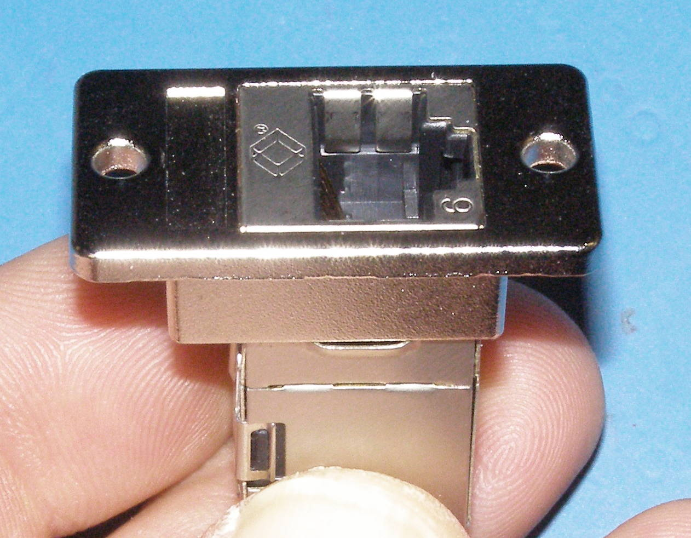
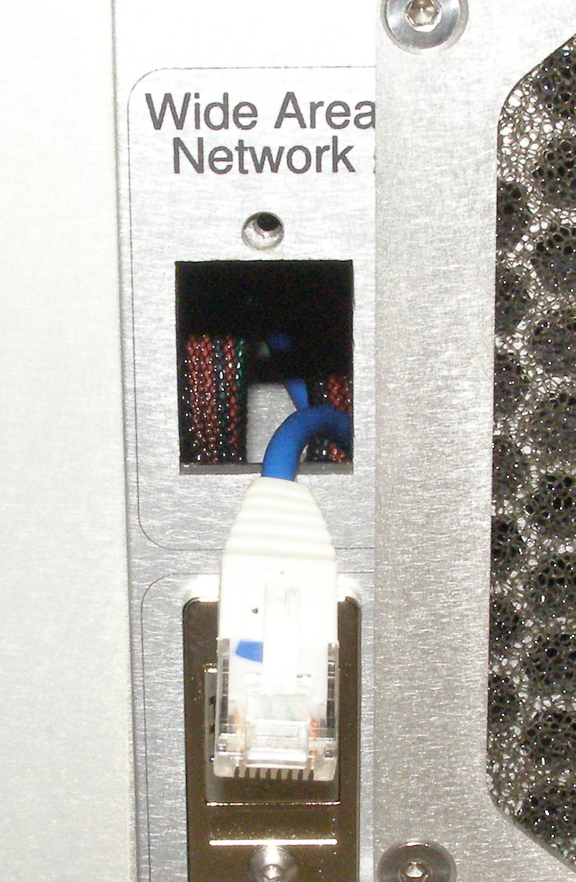
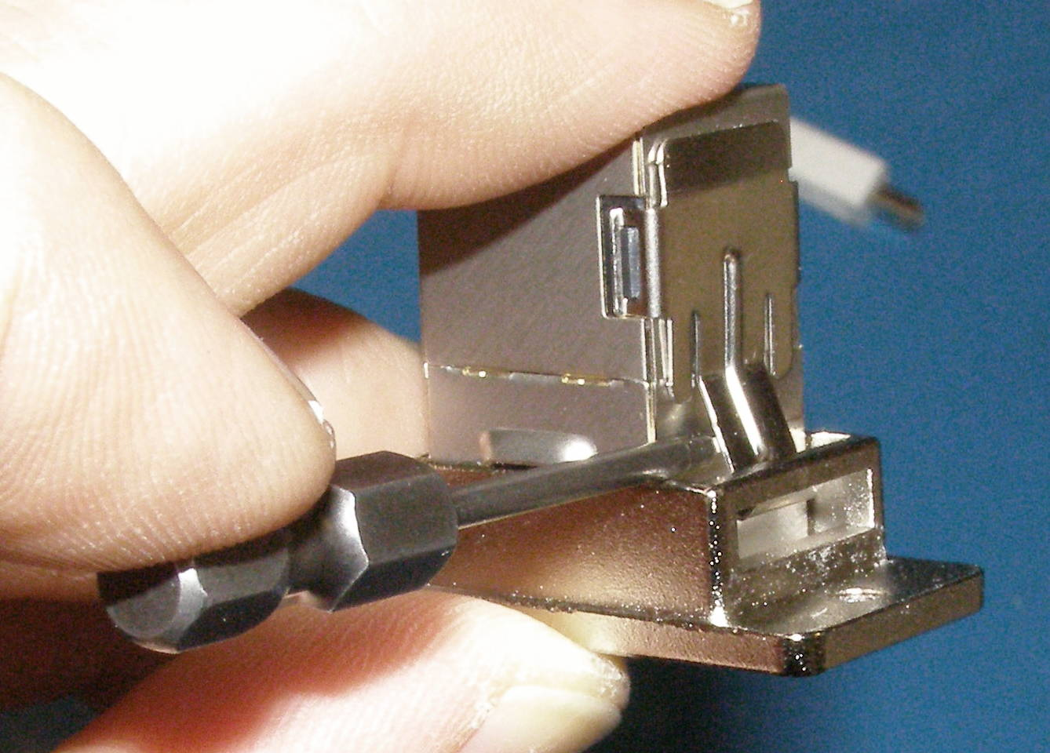
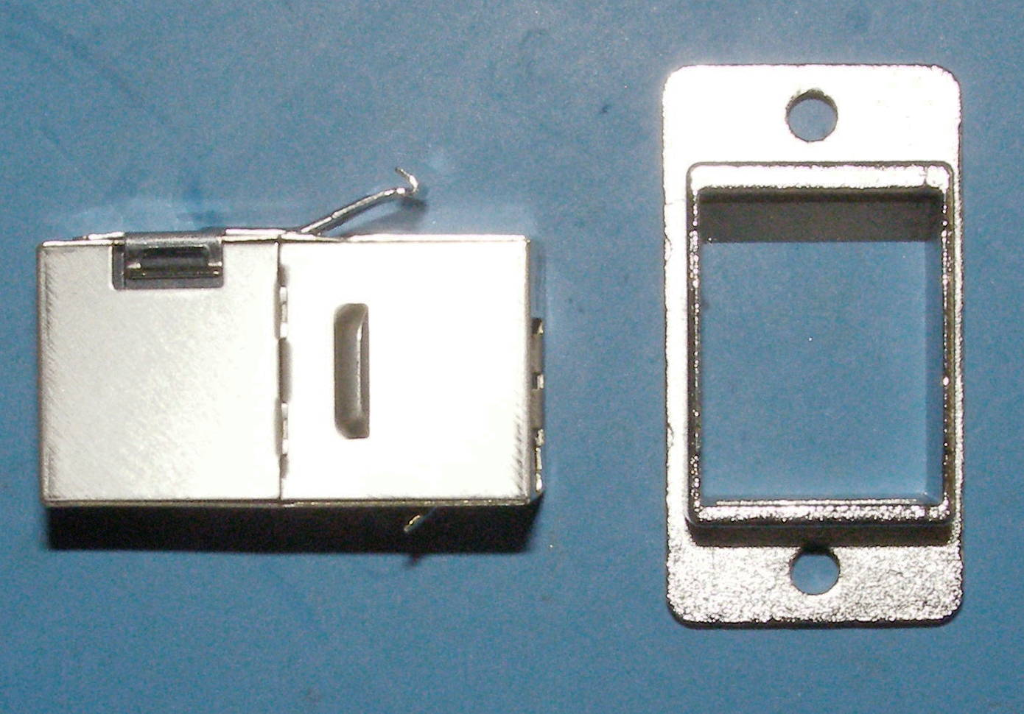
Wide Area Network Conector Repair (1)
Panel Mount RJ45, Removal - 1205
  Using the 2mm bit with the T-handle driver, remove the 2 screws. 3054-10 (Fig 1)
  Using the needle nose pliers or any reasonable means, extract the RJ45 connector from within the robot. (Fig 2)
  Undo the latch and remove the RJ45 connector.
  (Fig 3,4)
RJ45, Install
  Snap the RJ45 connnector into the panel mounting flange (Fig 5)
  Make sure that the RJ45 is fully seated in the flange. It will only mount in one direction. (Fig 6)
  Verify that the retaining spring arm is fully seated in its slot by inserting the 1.5mm bit as shown. (Fig 7)
Fig 5
Fig 1
Fig 6
Fig 2
Fig 7
Fig 4
Fig 3

Slide 3
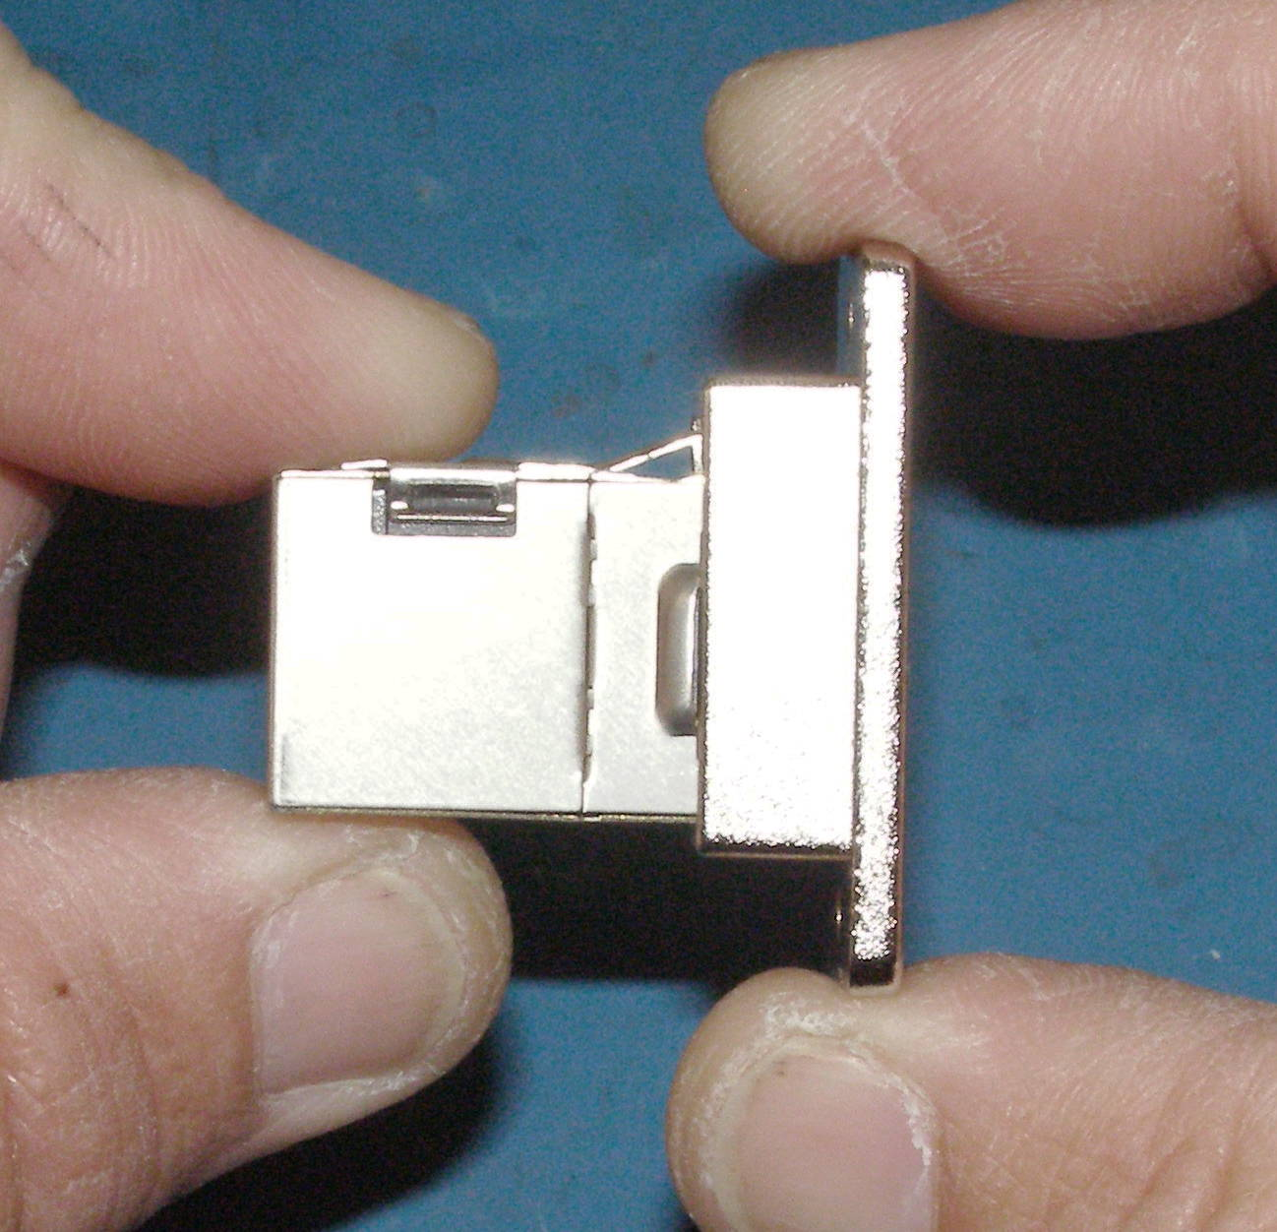
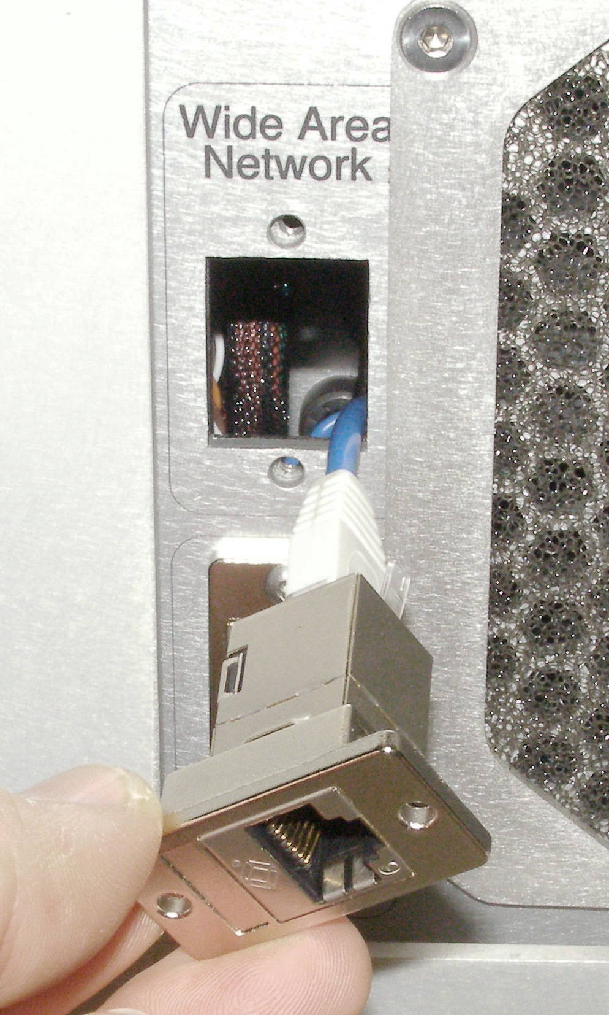
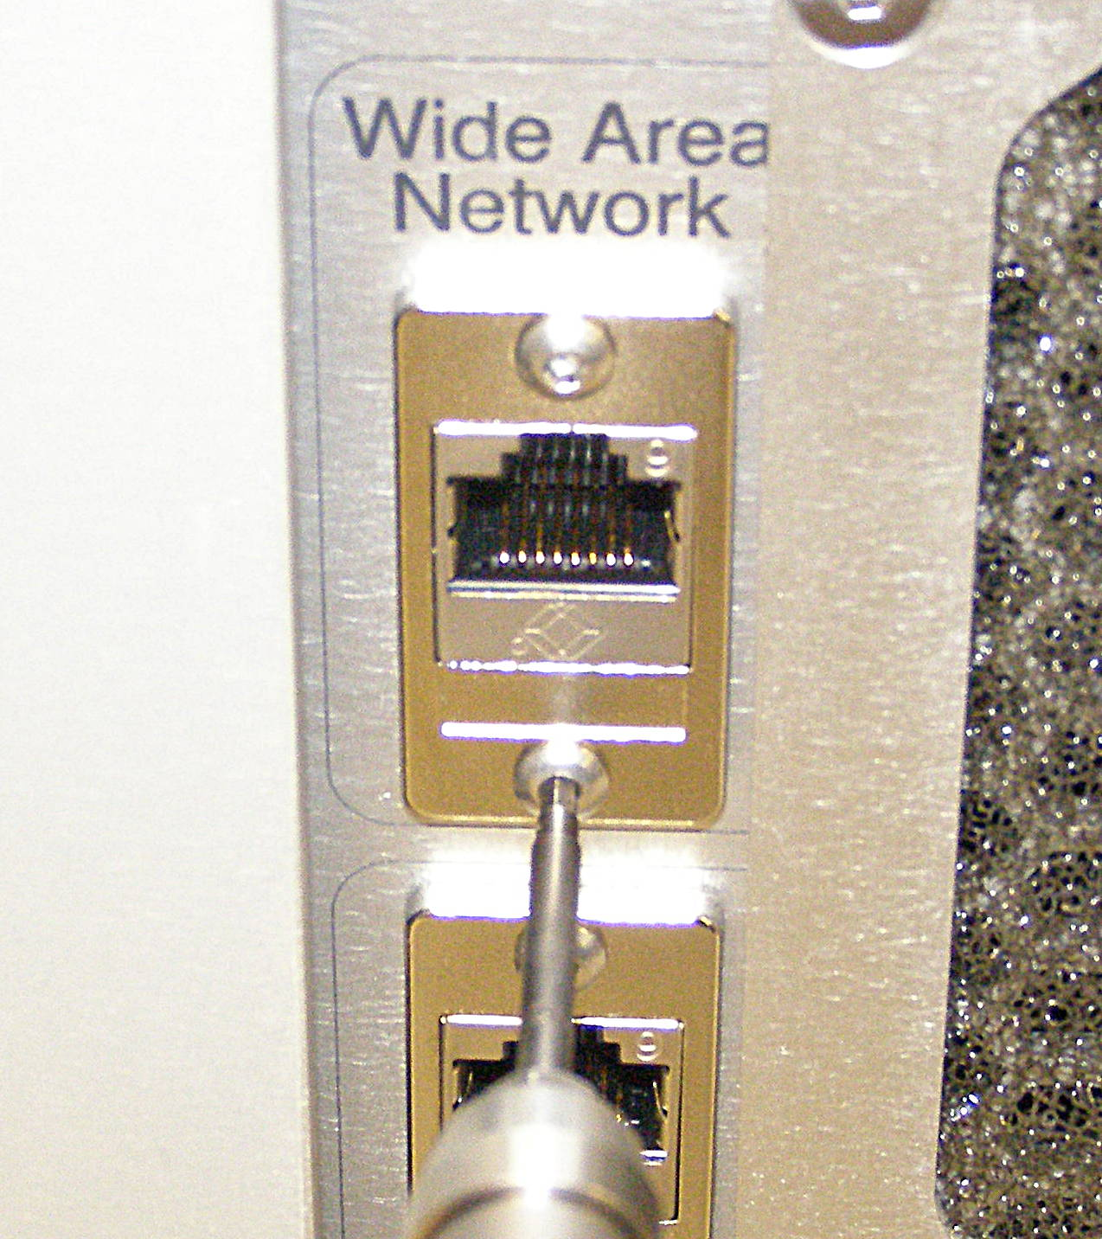
Wide Area Network Conector Repair (2)
  Verify that the retaining spring arm is not damaged and is latching the RJ45 securly by gently tugging on the RJ45. It should not pull out. (Fig 8)
  Snap the cable back into the RJ45 connector.
  (Fig 9)
  Do not use Loctite. Torque the screws to 0.68Nm using the Small torque driver. Connector snap should be up. (Fig 10)
Fig 8
Fig 9
Fig 10

